Slide 1
dotCSS
14th of November, 2014

Slide 2
8 Talks (18min) 5 Lightning Talks (5min)

Slide 3
Talks

Slide 4
20 years of CSS: maturity or senility
2.1.1 - Daniel Glazman Co-chairman of the CSS Working Group

Slide 5
Hugo Agbonon: Daniel Glazman, co-chairman of the W3C CSS Working Group, gave a talk explaining CSS' various problems, and how hard it seems to be for it to move forward while trying to reach good compromises on browser vendors needs and priorities. For example, he mentionned the infamous difficulty to vertically center elements of CSS, and talked about how hard it was to even name properties.

Slide 10
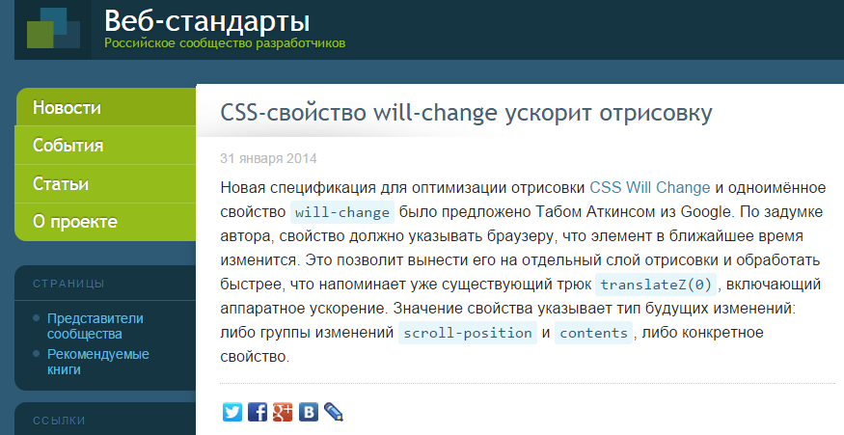

Slide 12
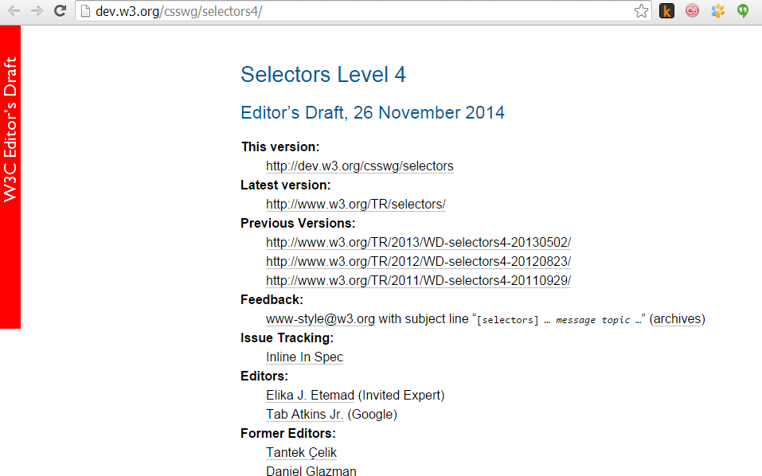

Slide 13
?
2.1.2 Kaelig Deloumeau-Prigent
Author and Front-end Developer at FT Labs

Slide 14
Hugo Agbonon: Kaelig Deloumeau-Prigent talked about his work at The Guardian to bridge the gap between developers and designers. Sass, and especially clearly named variables, allow better understanding for both developers and designers of how front-end elements are thought and standardized throughout the project. His idea was to put the design at the center of the project.

Slide 15
Ten Principles for Effective Front-end Development
2.1.3 - Harry Roberts
Creator of inuit.css Author of CSS guidelines

Slide 18
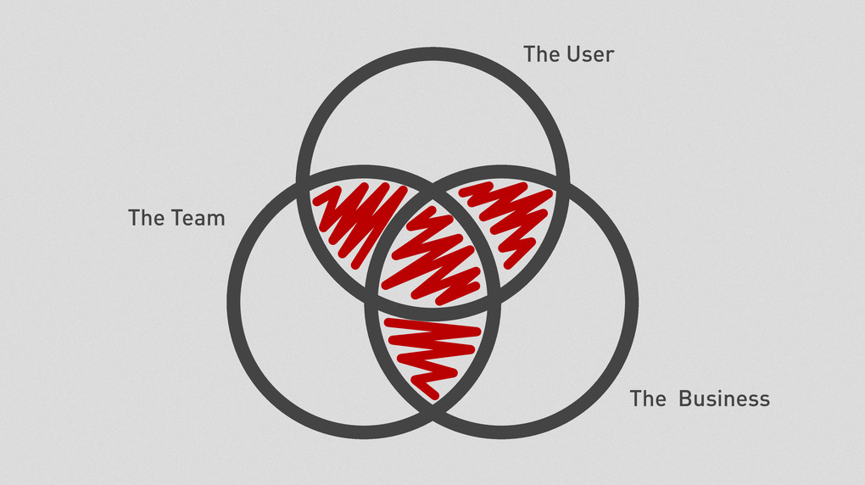

Slide 26
Keep Calm And Write Sass
2.1.4 - Hugo Giraudel
Maintainer of SassDoc Sass Writing Machine

Slide 27
Hugo Agbonon: Hugo Giraudel presented principles to work with Sass: KYSS - Keep Your Sass Simple(, Smart & Straightforward), extending KISS Sass - it's not all bright an shiny Don't do everything in Sass Stick to http://cssguidelin.es, use scss-lint, px-to-rem, autoprefixer Clean unused code Test Document

Slide 28
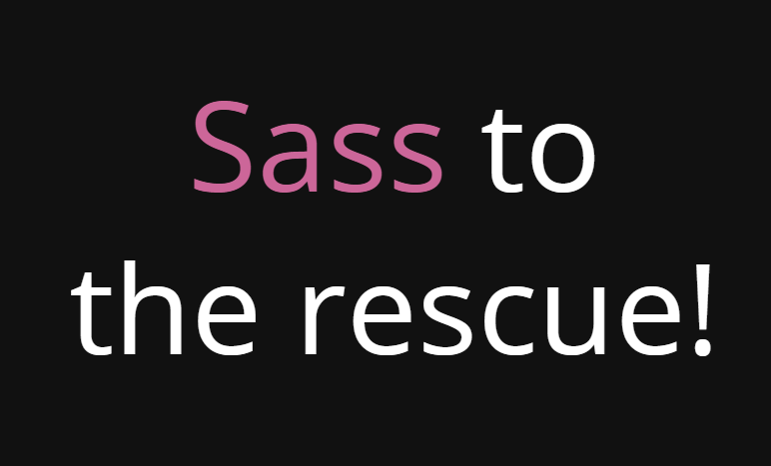

Slide 29
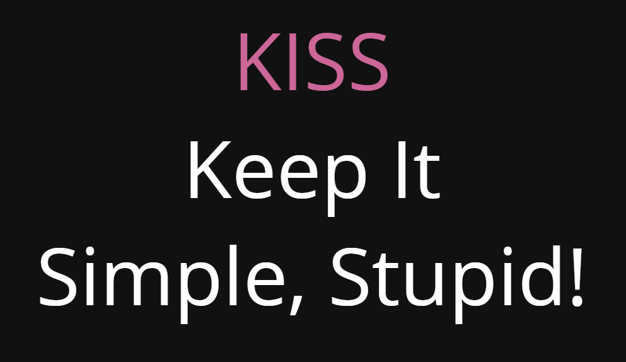

Slide 30
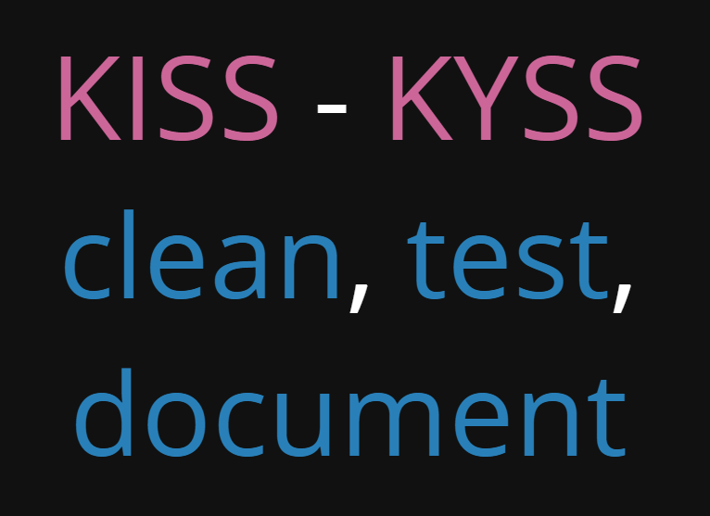

Slide 33
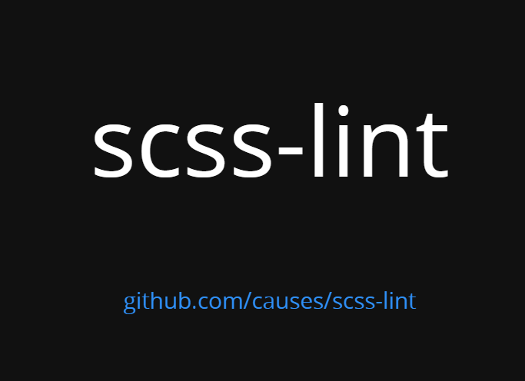

Slide 37
CSS? WTF!
2.1.5 - Estelle Weyl
Standardista, trainer & author
Creator of the Clown Car technique

Slide 38
Hugo Agbonon: Estelle Weyl talked about less-known things CSS can do, like counting with counter, then about selectors specificities in her CSS? WTF! talk, which ended with notes about how to (not) use !important and how to override it with CSS animation quirks.

Slide 39
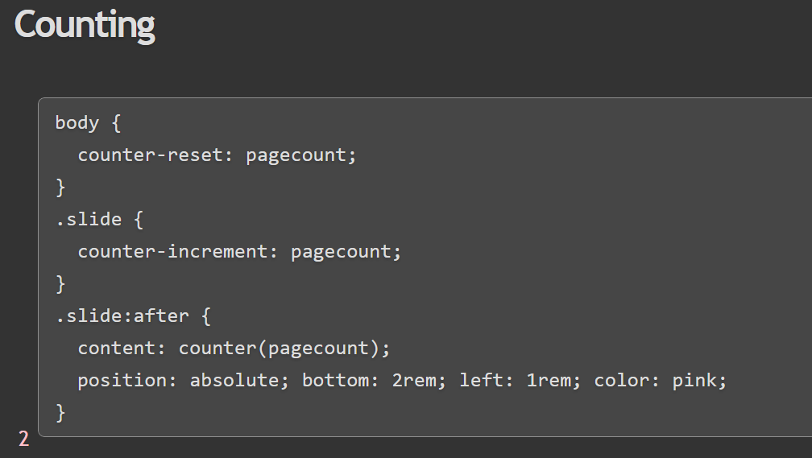

Slide 40
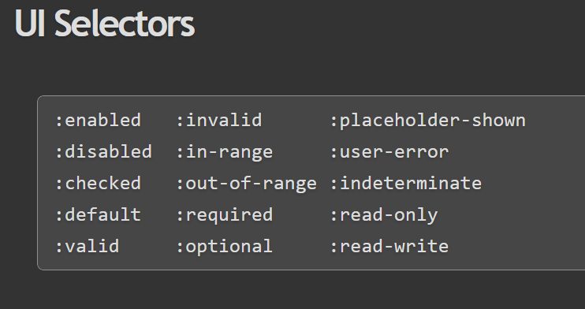

Slide 41
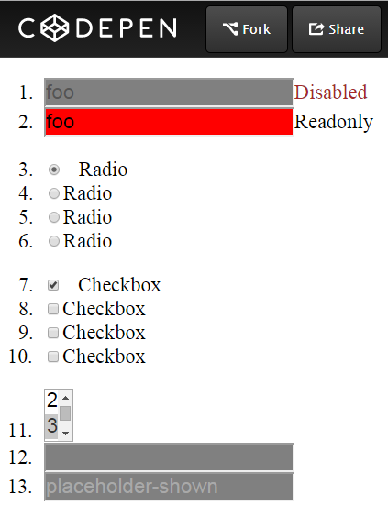

Slide 42
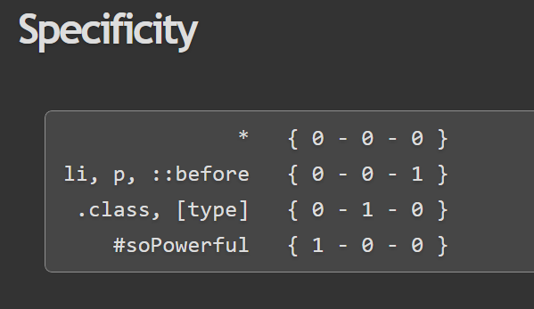

Slide 43
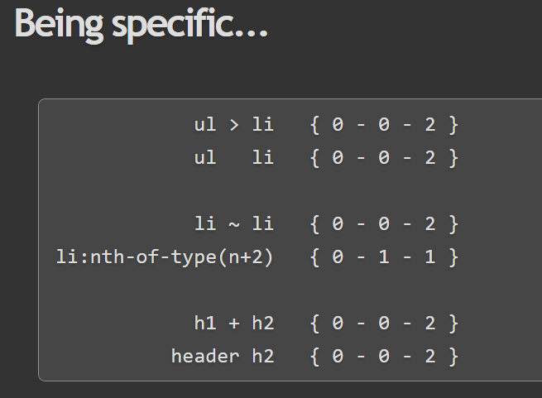

Slide 44
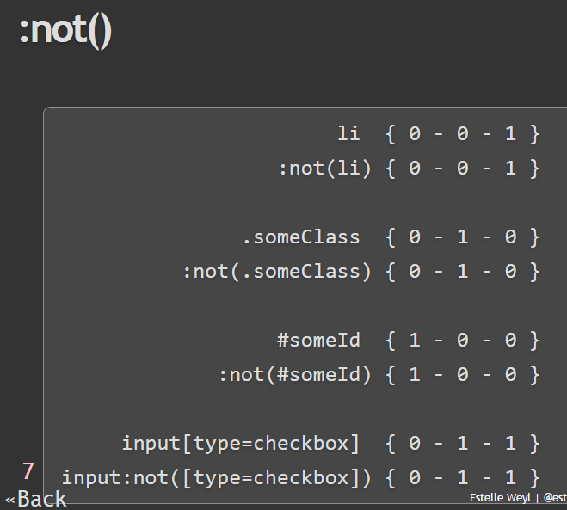

Slide 45
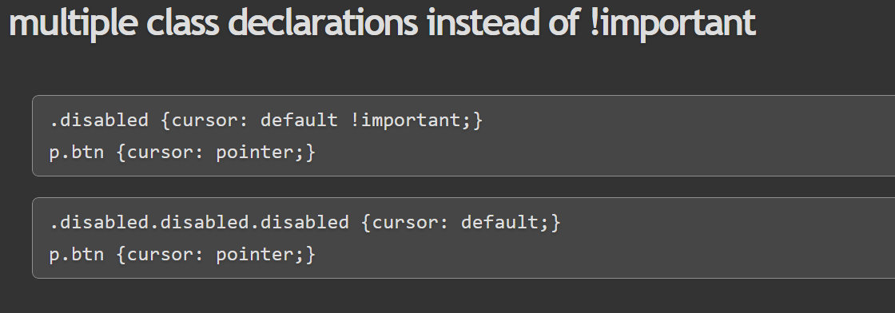

Slide 46
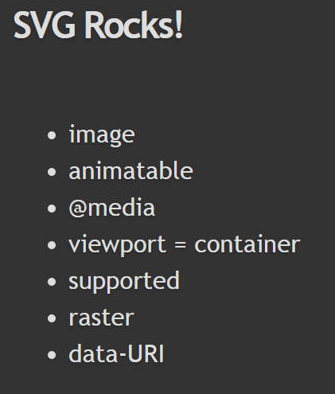

Slide 47
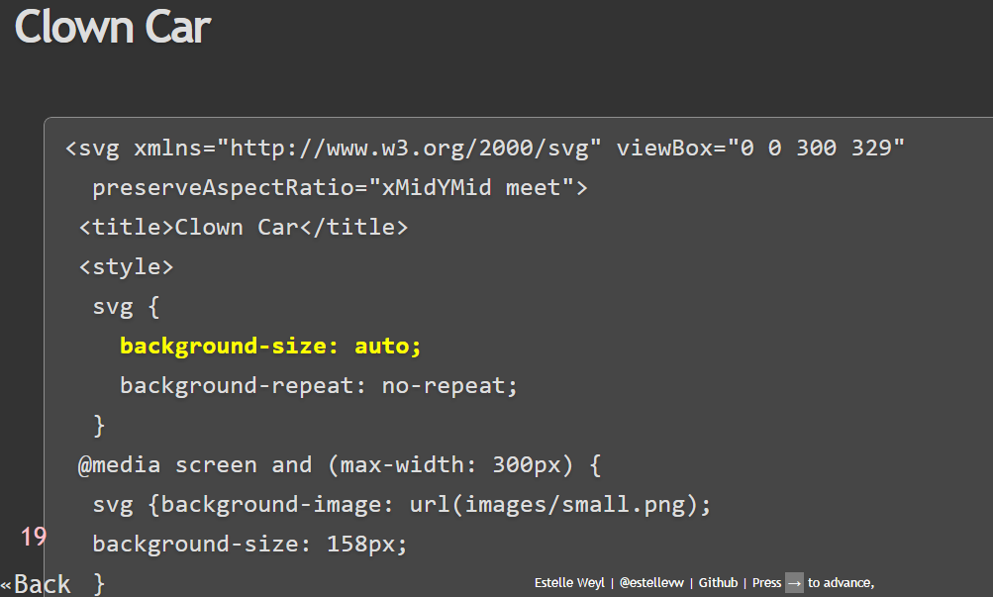

Slide 49
http://www.standardista.com/wp-content/uploads/2012/01/specificity3.pdf

Slide 50
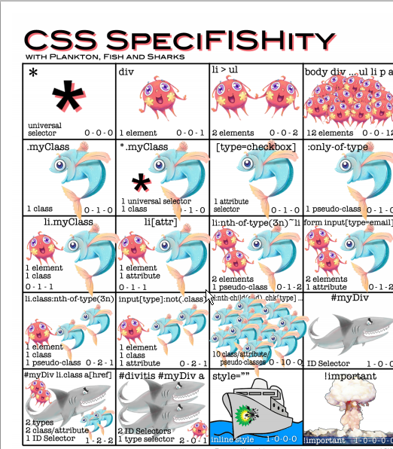

Slide 52
Making Twitter UI Infrastructure
2.1.6 - Nicolas Gallagher
Creator of Normalize.css & suit.css

Slide 53
Hugo Agbonon: Nicolas Gallagher talked about scalable CSS, and how, in a large company like Twitter, the whole UI has to be designed in order to avoid having developers stepping on each other's toes.

Slide 54
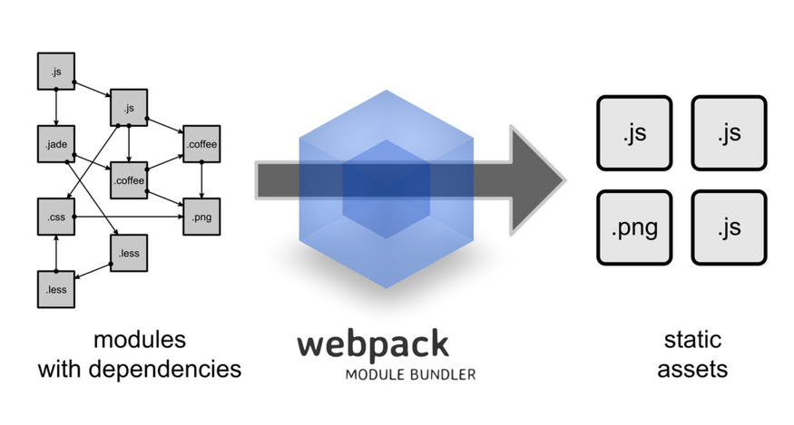

Slide 55
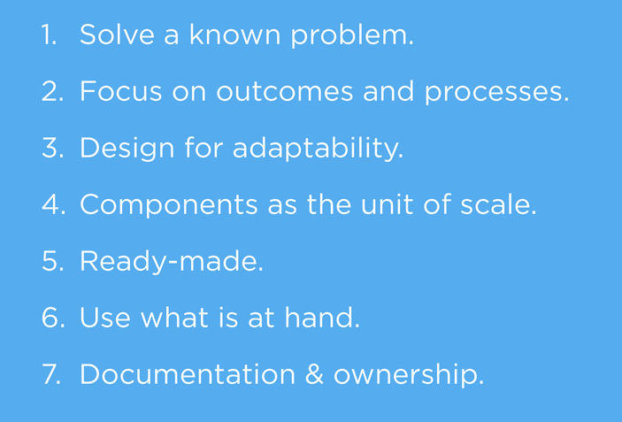

Slide 56
?
2.1.7 - Bert Bos
W3C Staff contact of the CSS WG -

Slide 57
Hugo Agbonon: Bert Bos, co-creator of CSS, talked about typography, giving clear examples of the challenges linked to it, which may or may not be fixed with CSS. For example, quotes are different in French, English, Dutch ; punctuation and style can be different (spaces before ! and ? in French, not English), so is it possible to markup in a consistent way text?

Slide 58
Distributions
2.1.8 - Ana Tudor
CSS & Maths tamer, creating insane experiments

Slide 59
Hugo Agbonon: Ana Tudor (@thebabydino), the last speaker, showed a series of neat demos about distribution, creating fun shapes with CSS/Sass. Her neat demos are on Codepen.

Slide 60
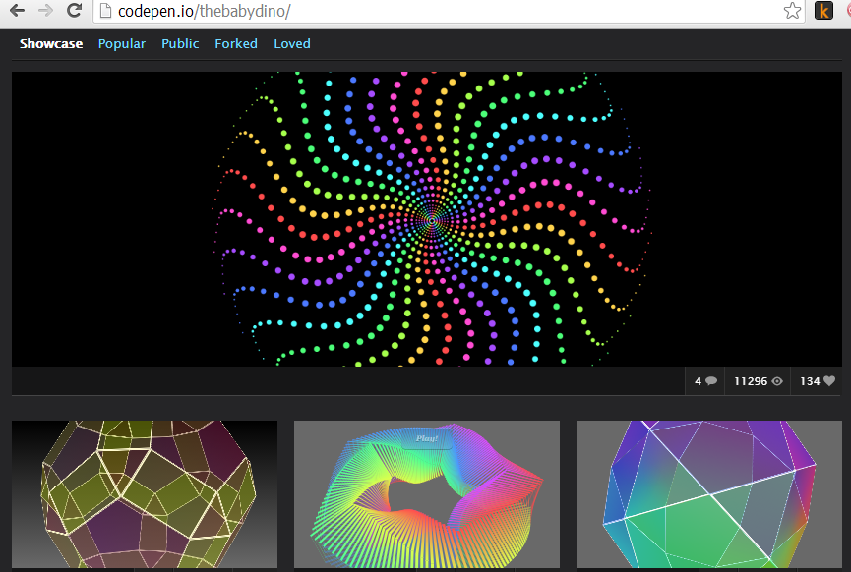

Slide 61
http://codepen.io/thebabydino/

Slide 62
Lightning Talks

Slide 63
Back to the CSS
2.2.1 - Maxime Thirouin

Slide 64
Hugo Agbonon: Maxime Thirouin summed up what was basically the feeling of the whole conference : "We love CSS, but it's frustrating". That it still has (without preprocessors) no variables, math, customization... which is why he is building cssnext, to get the next standardized features now.

Slide 65
http://cssnext.github.io/

Slide 66
Functionality in CSS
2.2.2 - Gregor Adams

Slide 67
Hugo Agbonon: Gregor Adams talked about functionalities in CSS to dynamically style elements

Slide 68
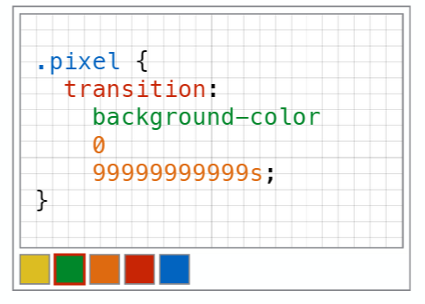

Slide 69
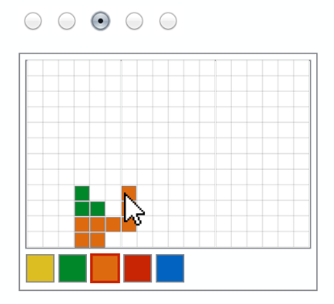

Slide 70
one-element rules
2.2.3 - Tim Pietrusk

Slide 71
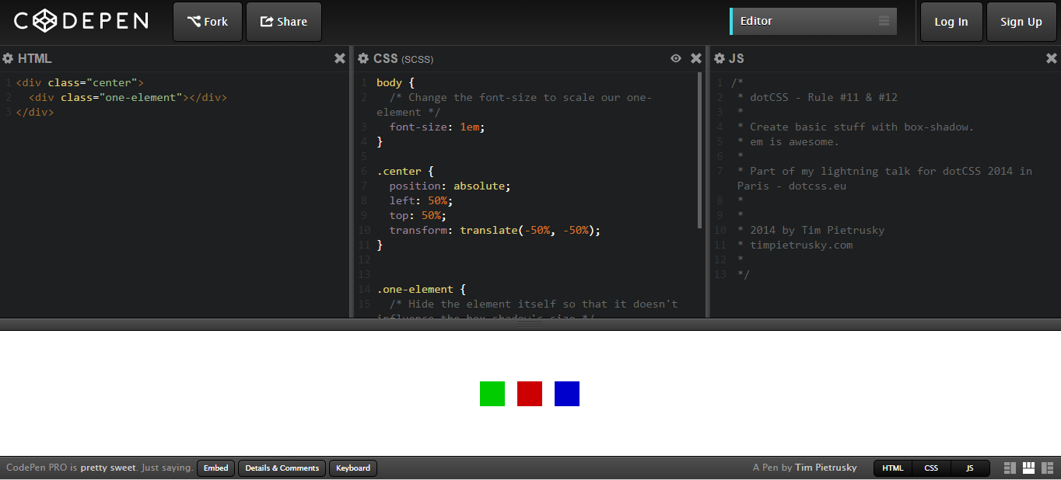

Slide 72
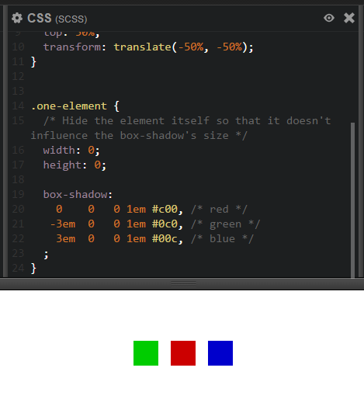

Slide 73
CSS Parallax
2.2.4 - Guido Bouman

Slide 74
Hugo Agbonon: Guido Boman talked about CSS parallax scrolling done right, and an implementation of it by Keith Clark full css implementation of parallax scrolling.

Slide 75
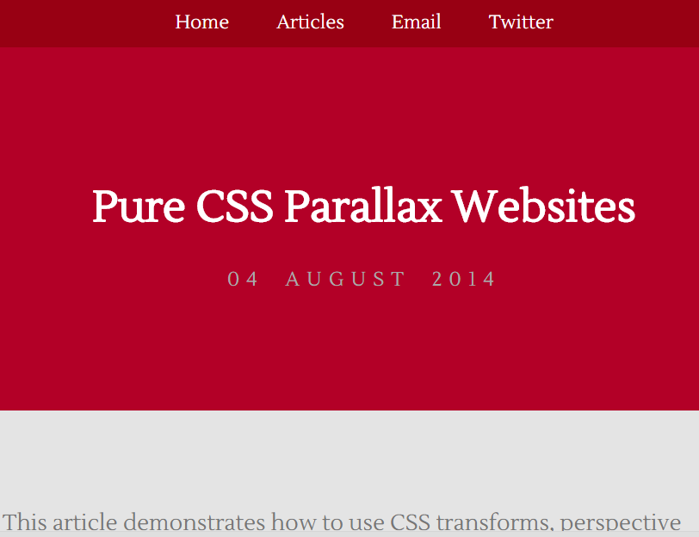

Slide 76
http://keithclark.co.uk/articles/pure-css-parallax-websites/

Slide 77
In 25 years of Web, what did - you do for the promises of an accessible Web?
2.2.6 - Victor Brito

Slide 78
Web accessibility means that people with disabilities can use the Web

